Slide 1
Hazard Mitigation Grant Program Summer 2018 California Wildfires and High Winds DR-4382

Slide 2
Agency Logos

Slide 3
Hazard Mitigation Grant Program (HMGP) Overview
The key purpose of HMGP is to implement mitigation measures that reduce loss to life and improved property from future disasters
Projects must implement long-term stand alone risk reduction strategies
Creation of or updating current single jurisdiction or multi-jurisdiction Local Hazard Mitigation Plans (LHMP)

Slide 4
404 vs 406 Mitigation
404 and 406 refer to the applicable section of the Robert T. Stafford Act
406 mitigation includes the repair, restoration, reconstruction, or replacement of public facilities damaged or destroyed by a major disaster and is funded through Public Assistance
404 mitigation (Hazard Mitigation Grant Program) is a competitive grant program focused on mitigating risks from future disasters through the implementation of long-term independent solutions to increase protection and/or capacity of existing/fully functioning facilities

Slide 5
Priorities
Post-wildfire/watershed mitigation activities
Wildfire mitigation activities
Climate Resiliency Mitigation Actions
Climate adaptation projects

Slide 6
Post Wildfire Mitigation
Soil stabilization measures
Erosion control solutions
Flood control and drainage improvements
Storm water management
Increase debris basin capacity

Slide 7
Wildfire Mitigation
Hazardous fuels reduction/vegetation management
Within two miles of improved property or critical infrastructure/facilities
Defensible space
Public facilities and infrastructure
Private property defensible space programs
Ignition resistant construction
Public facilities
Private property programs (eave vents, fire resistant roofing, fire resistant siding)

Slide 8
Climate Resiliency Mitigation Actions and Climate Adaptation Projects
Climate Resiliency Mitigation Actions (CRMA)
Flood diversion and storage
Floodplain and stream restoration
Aquifer storage and recovery
Green Infrastructure
Climate Adaptation Projects
Sea level rise
Green space for Wildland Urban Interface (WUI) areas

Slide 9
Other Eligible Activities
Local Hazard Mitigation Plans
Localized/Non-localized flood risk reduction
Seismic retrofitting of existing buildings
Elevations and acquisitions
Infrastructure retrofitting
Mitigation reconstruction
Culvert upsizing
Dry Floodproofing
Critical facility generators
Post-disaster code enforcement
Early warning systems

Slide 10
Ineligible Activities – Slide 1
Projects for which actual physical work has occurred prior to approval and obligation
Projects that do not implement a long term stand alone risk reduction strategy
Projects contingent upon another project or action to be effective
Projects that cannot be completed within 36 months

Slide 11
Ineligible Activities – Slide 2
Studies or investigations
Emergency response activities or equipment (e.g. fire engines)
Flood control projects related to the repair or replacement of dams and other flood-control structures
Projects that address the operation, deferred/future maintenance, rehabilitation, restoration, or replacement of existing structures, facilities, or infrastructure, without increasing the level of protection

Slide 12
Eligibility Requirements – Part 1
Eligible Subapplicants:
State Agencies
Local Governments: Cities and Counties
Special Districts
Federally Recognized Tribes
Private Nonprofit Organizations

Slide 13
Eligibility Requirements – Part 2
Eligible Subapplicants Continued:
MUST have a FEMA-approved and adopted Local Hazard Mitigation Plan
75% Federal Share / 25% Local Cost Share – Cal OES does not contribute to the local cost share requirement for HMGP
36 month Period of Performance (POP) - begins once the project is approved by FEMA
Must obtain environmental clearances under CEQA
NO CONSTRUCTION PRIOR TO APPROVAL

Slide 14
Funding Limitations
Funding Limitations for Planning Subapplications:
Single Jurisdiction Local Hazard Mitigation Plans:
$125,000
Multi-Jurisdiction Local Hazard Mitigation Plans:
$250,000

Slide 15
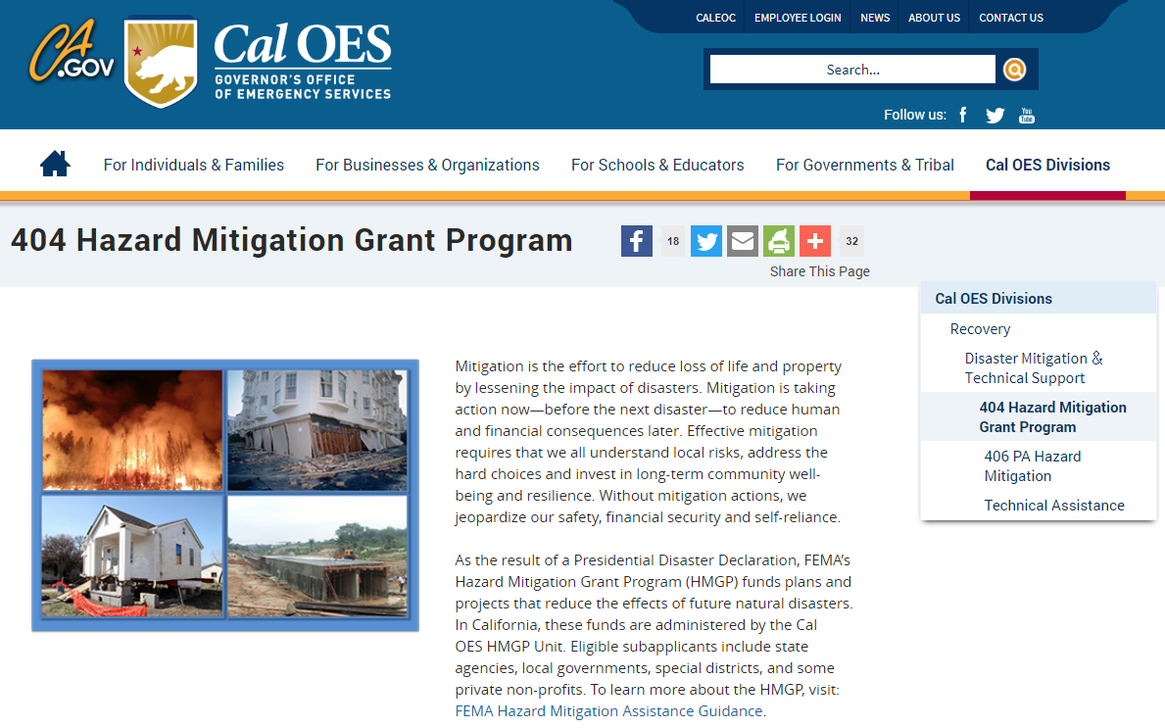
Notice of Interest (NOI)
NOI period:
August 20 - October 5, 2018
Funding available for:
All eligible project types
Local Hazard Mitigation Plans
Visit our website:
Cal OES HMGP Website

Slide 16
Subapplication Development and Benefit-Cost Analysis Workshops
Two day workshops offering training and one-on-one assistance regarding the HMGP subapplication and FEMA Benefit Cost Analysis (BCA) tool for jurisdictions with approved NOIs
Dates, times, and locations to be determined
Stay tuned for more information on our website

Slide 17
Additional Funding Opportunity Pre-Disaster Mitigation (PDM) Grant Program
Annual appropriation from Congress
Competitive nationwide ($232 million)
Notice of Funding Opportunity (NOFO)
All applications submitted through eGrants
Check our site for more information:
Cal OES Website (http://www.caloes.ca.gov/)
Search “Pre-Disaster & Flood Mitigation”
Email: PDFM@caloes.ca.gov

Slide 18
Direct all related questions to:
HMGP@CalOES.ca.gov

