Slide 1
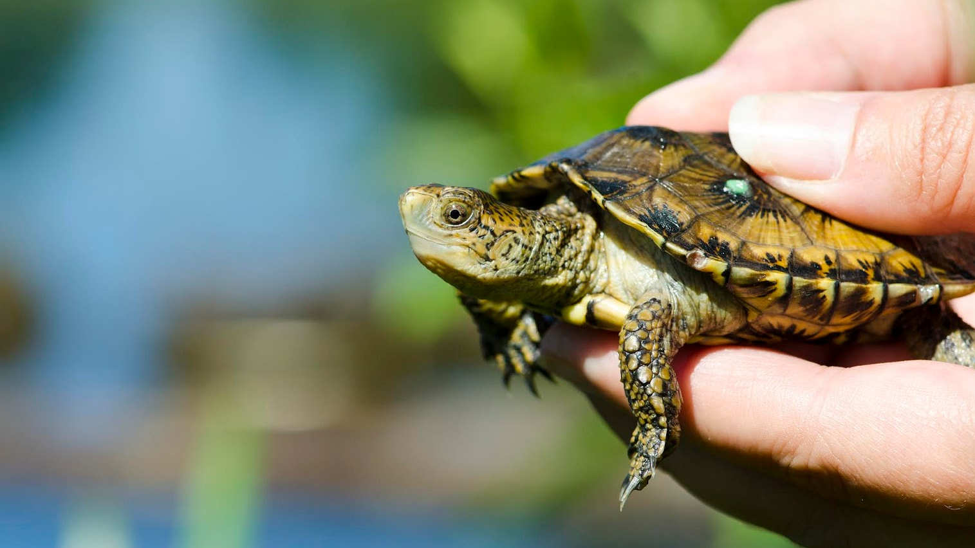
Predicting extinction risk for northwestern & southwestern pond turtles
Kaili M. Gregory
University of Florida/Georgia
Presentation for San Diego
Management & Monitoring Program
24 April 2024
Image: Ryan Hawk, Woodland Park Zoo

Slide 2
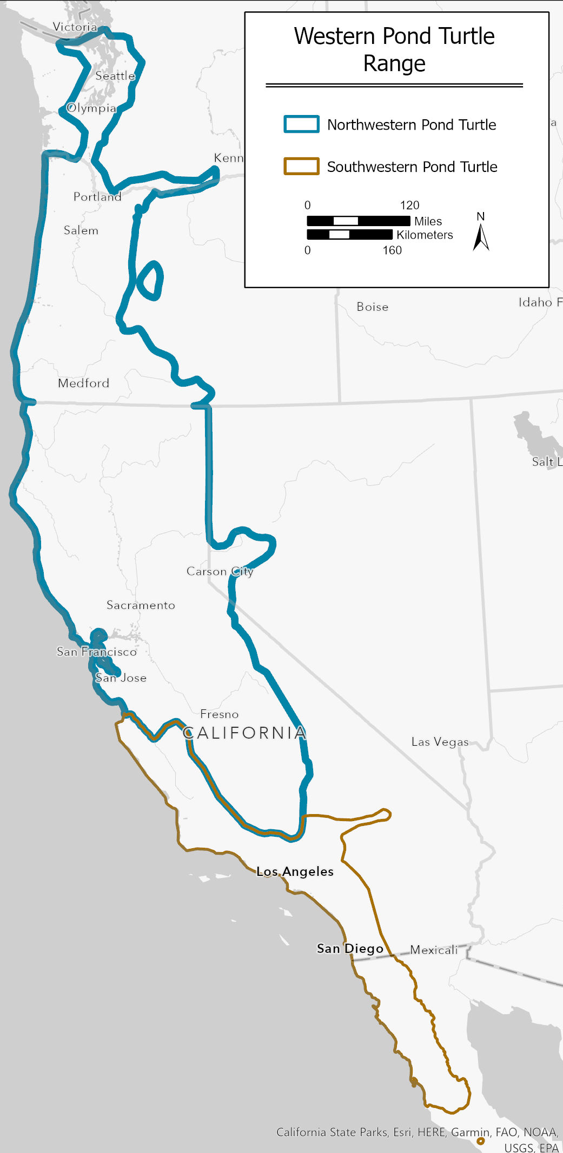
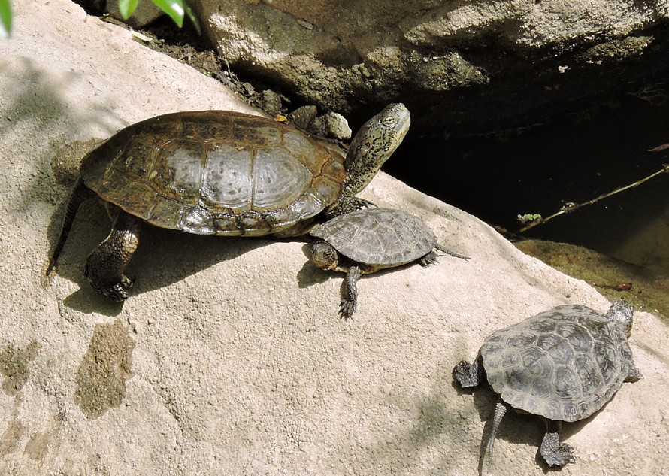
Study species
Northwestern (NWPT) and southwestern (SWPT) pond turtle (Actinemys marmorata, Actinemys pallida)
  Formerly the western pond turtle (A. marmorata)
Long lived (40+ years) freshwater turtle
Map: Kat Powelson
USFWS Ventura Office
Consideration for listing under the U.S. Endangered Species Act
  Proposed as Threatened
Image: Brian Hubbs

Slide 3
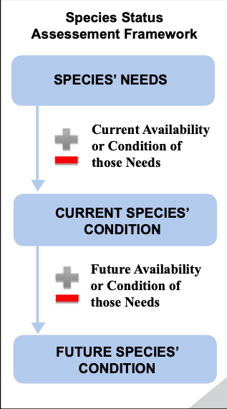
Context
Decision support science for listing decision
Species Status Assessment (SSA)
Opportunity to use predictive modeling for current & future conditions

Slide 4
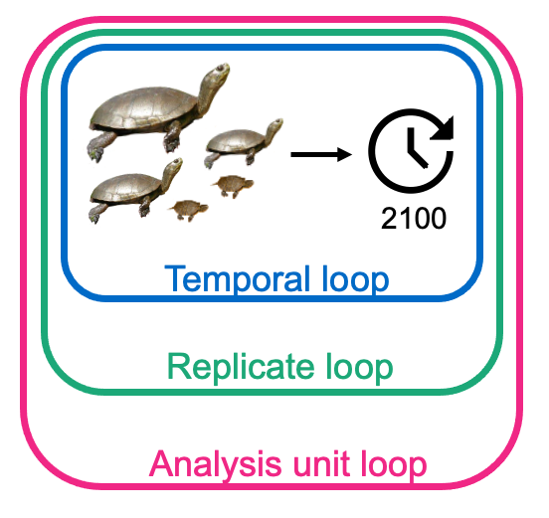
Model structure
Triple loop stochastic simulation of a population viability analysis
Threats to the species:
  Drought
  Invasive species (American bullfrog)
  Habitat loss
Notes:
Drought – climate change effect

Slide 5
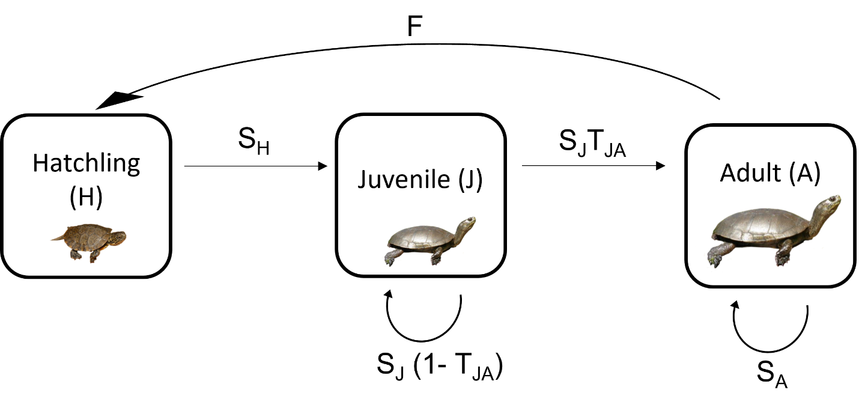

Life history
$$A =\left[\begin{matrix}0 & 0 & \text{F} \\ \text{S}\text{H} & \text{S}\text{J}\text{(1− }\text{T}\text{JA}\text{) } & 0 \\ 0 & \text{S}\text{J}\text{T}\text{JA} & \text{S}\text{A} \end{matrix}\right]$$

Slide 6
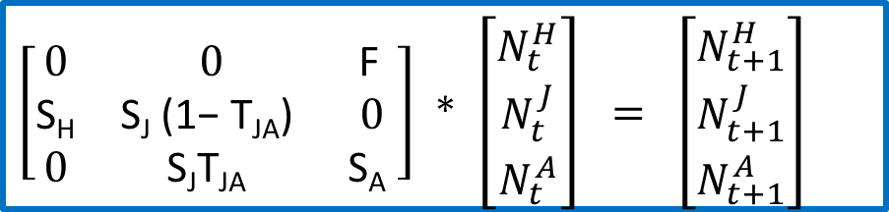
Model structure
$\left[\begin{matrix}0 & 0 & \text{F} \\ \text{S}\text{H} & \text{S}\text{J}\text{ (1− }\text{T}\text{JA}\text{) } & 0 \\ 0 & \text{S}\text{J}\text{T}\text{JA} & \text{S}\text{A} \end{matrix}\right]$ * $\left[\begin{aligned}N_{t}^{H} \\ N_{t}^{J} \\ N_{t}^{A}\end{aligned}\right] = \left[\begin{aligned}N_{t+1}^{H} \\ N_{t+1}^{J} \\ N_{t+1}^{A}\end{aligned}\right]$
Life history
Current
abundance
Next year’s
abundance
Notes:
AU loop – spatial structure loop

Slide 7
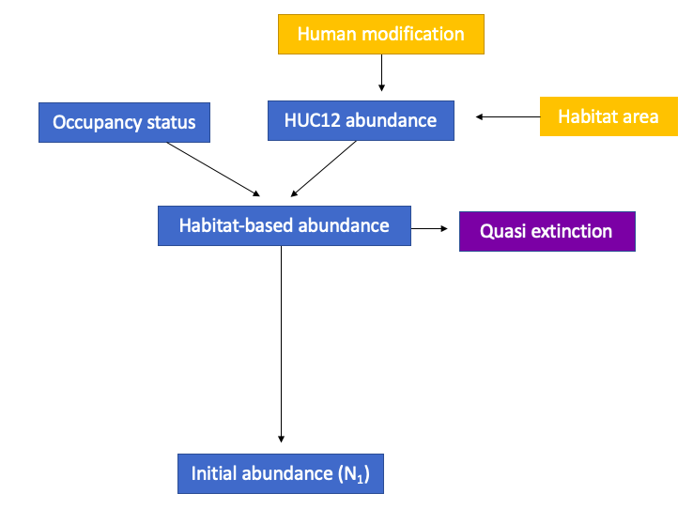
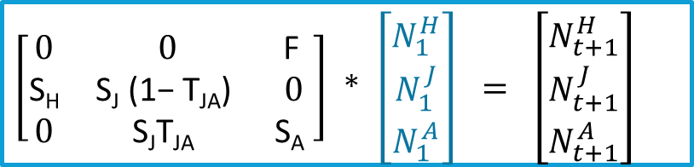
Initial abundance
$\left[\begin{matrix}0 & 0 & \text{F} \\ \text{S}\text{H} & \text{S}\text{J}\text{ (1− }\text{T}\text{JA}\text{) } & 0 \\ 0 & \text{S}\text{J}\text{T}\text{JA} & \text{S}\text{A} \end{matrix}\right]$ * $\left[\begin{aligned}N_{1}^{H} \\ N_{1}^{J} \\ N_{1}^{A}\end{aligned}\right] = \left[\begin{aligned}N_{t+1}^{H} \\ N_{t+1}^{J} \\ N_{t+1}^{A}\end{aligned}\right]$
Notes:
Applying a quasi-extinction threshold instead of modeling full extinction is a widely accepted approach to account for small population effects, such as disease in the case of the WPT, without speculating on the functional form of the demographic effects. Quasi-extinction was defined as 5% of the ‘habitat-based’ abundance.

Slide 8
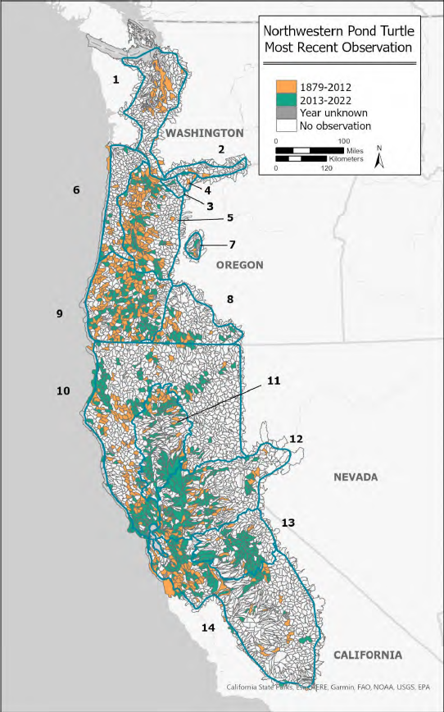
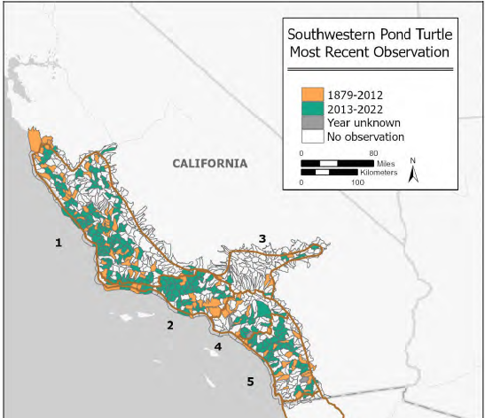
Occupancy status
$$occupancy status = Bernoulli ({S_{A}}^{\# years since observed})$$
Maps: Kat Powelson
USFWS Ventura Office

Slide 9
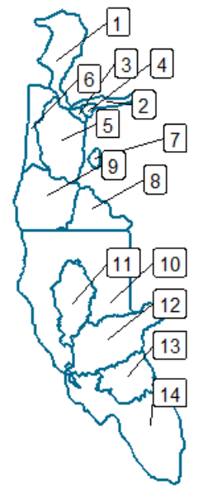
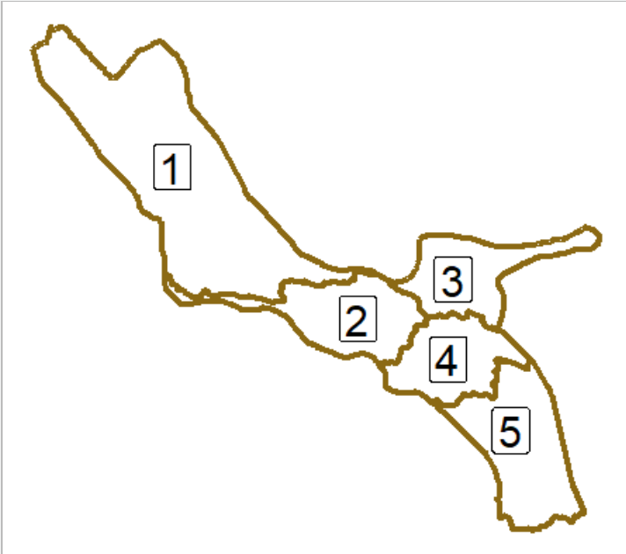
Northwestern
Analysis Units (AU)
Southwestern
Analysis Units (AU)
Notes:
Mention here that WA was not included

Slide 10
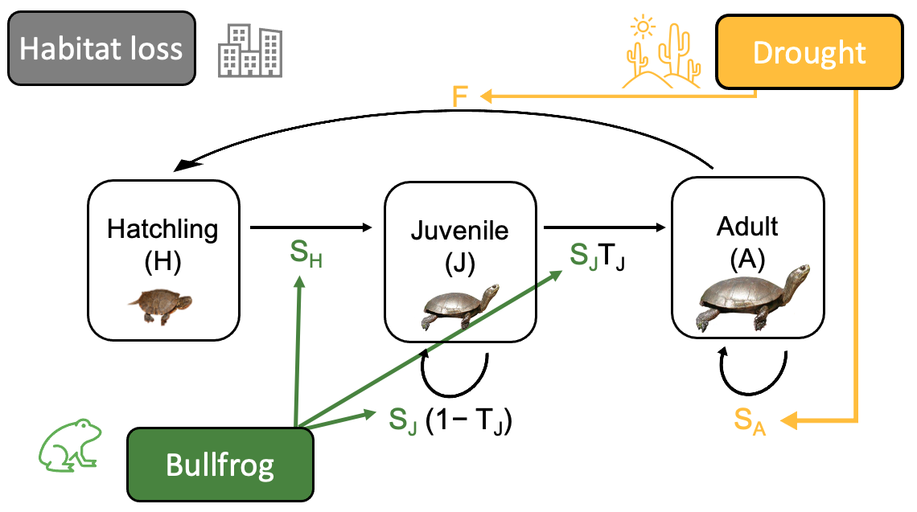
Life history

Slide 11

Drought
Intensity and duration (years)
Effects on survival of all stages and fertility
Current drought conditions
  PDSI data from NOAA & US Drought Monitor
Future conditions based on historic drought frequency
  1986-2005 vs 2006-2022 (IPCC)
Intensity | Duration | Reduction in survival (S_{H} , S_{J} , S_{A})
Moderate | 4+ | 59.8%
Extreme | 1 | 16.7%
 | 2 | 44.4%
 | 3+ | 95.3%
Moderate AND extreme | 4+ | 59.8% + 16.7%
Notes:
Mention that they’re based in literature, drought data sources from NOAA and US Drought monitor, structure of drought within the model, em

Slide 12

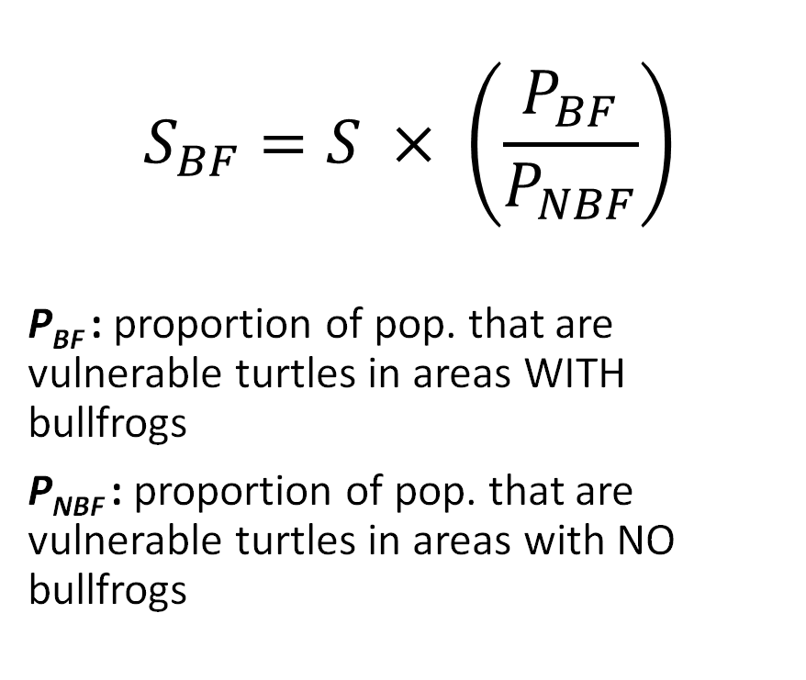
Bullfrogs
$$S_{BF}=S × \left(\frac{P_{BF}}{P_{NBF}}\right)$$
P_{BF} : proportion of pop. that are vulnerable turtles in areas WITH bullfrogs
P_{NBF} : proportion of pop. that are vulnerable turtles in areas with NO bullfrogs
Vulnerable stage classes
  Hatchlings
  Smaller juveniles
Magnitude of demographic effect
  Carapace length data in areas with and without bullfrogs

Slide 13

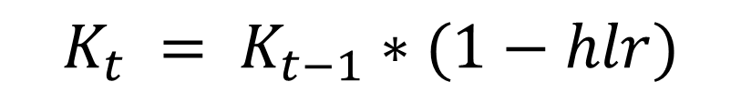
Habitat loss
Ceiling type density function based on carrying capacity (K)
K reduced each year based on a habitat loss rate (hlr)
Data: EPA’s ICLUS model
$$K_{t} = K_{t−1}∗(1−hlr)$$

Slide 14
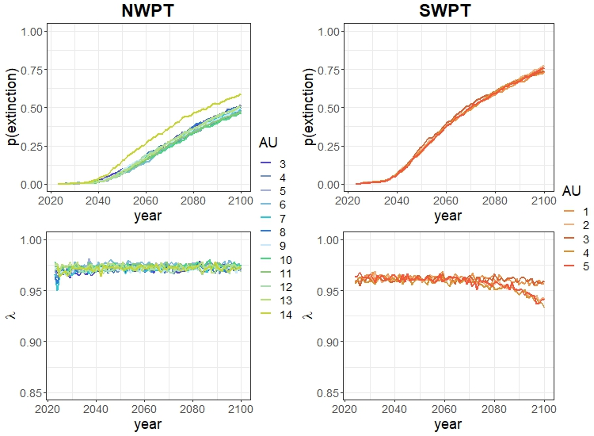
Results
Mean = 50%
+ 5.7% from base model
Mean = 75%
+ 17.7% from base model
Notes:
Define pop growth rates (<1 means neg growth)

Slide 15
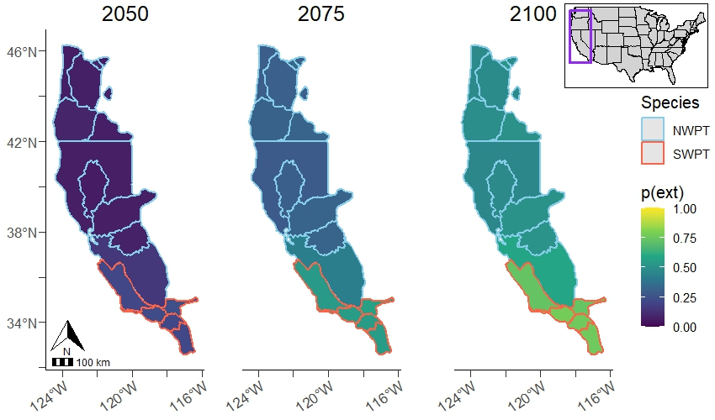
Results

Slide 16
Results
Notes:
Define pop growth rates (<1 means neg growth)

Slide 17
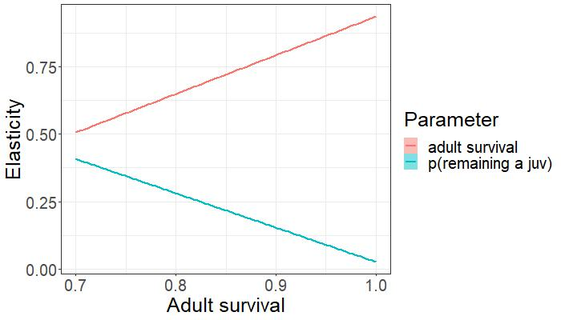
Results

Slide 18

Sensitivity analysis
Drought
Which threat(s) is probability of extinction most sensitive to?
Annual rate of change * 1.25
NWPT – bullfrogs
  P(ext) in 2100 increased by 8-12%
SWPT – drought
  P(ext) in 2100 increased by 5-19%
Bullfrog
Habitat loss

Slide 19
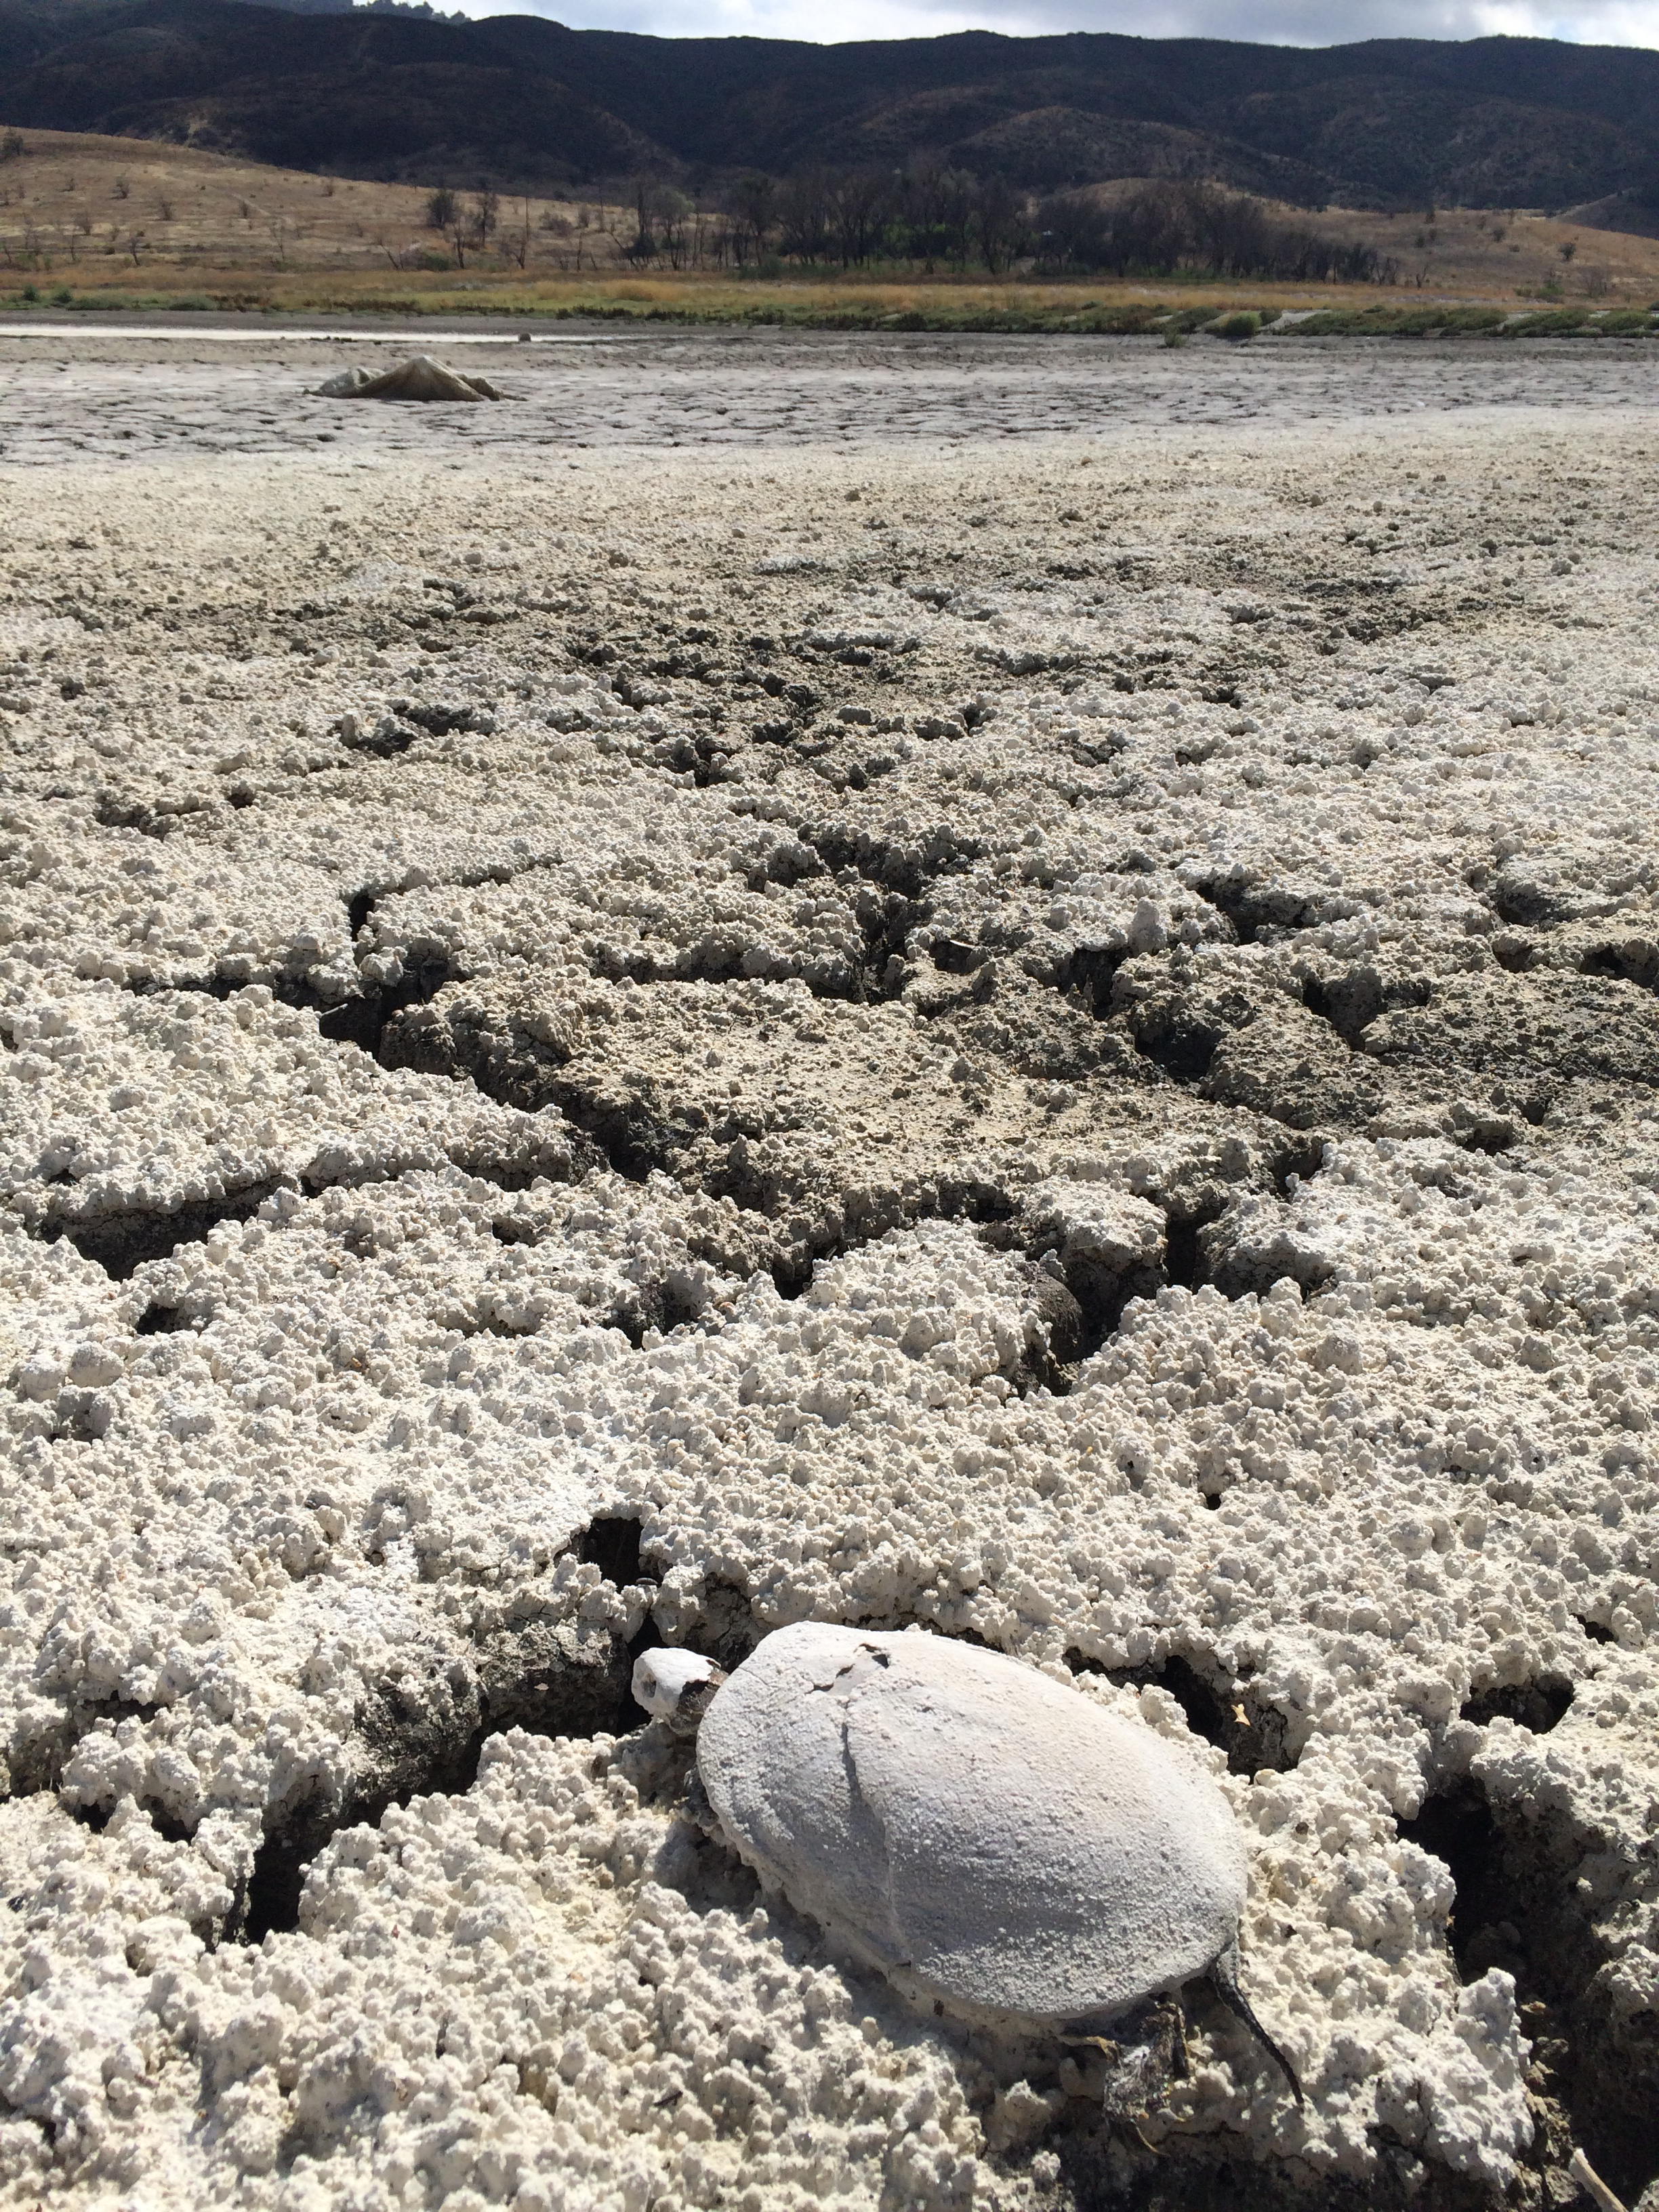
Discussion
Image: Jeff Lovich, USGS
Increase in extinction risk when threats are incorporated
  + 5.7% for NWPT, p(ext) = 50% in 2100
  + 17.7% for SWPT, p(ext) = 75% in 2100
Drought and bullfrog are most threatening to future viability
Likely underestimation of habitat loss

Slide 20
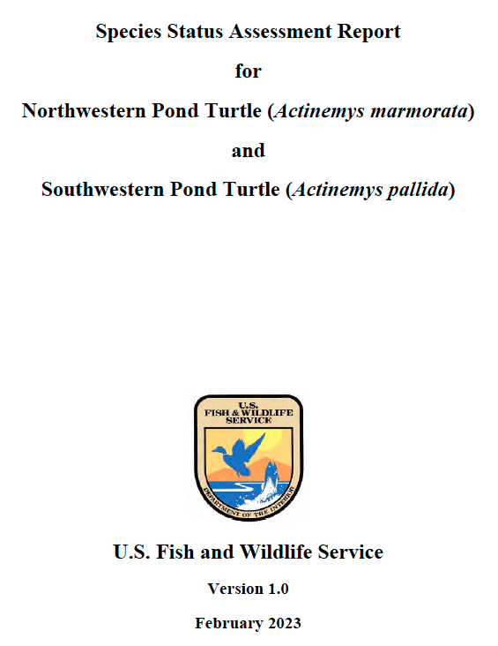
Conclusions
Image: Jeff Lovich, USGS
Direct integration into support science for Endangered Species Act listing decision
  Proposed as Threatened
Iterative, collaborative process with USFWS staff and species experts
Value of predictive modeling

Slide 21


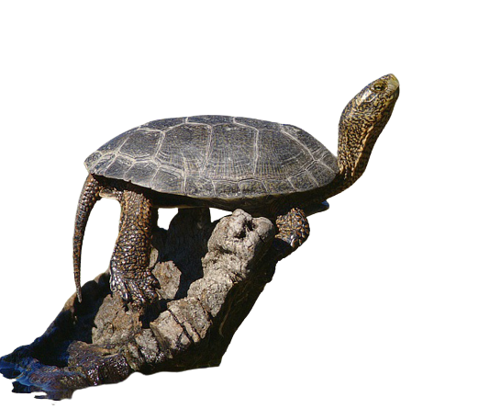

Acknowledgments
Conor McGowan
Cat Darst, Sam Lantz, Kat Powelson, Robert McMorran
Lab mates Ashley Goode, Francesca Erikson, Darcy Doran-Myers, Riley Andrade, El Pero
Pond turtle experts
USGS reviewers Brian Folt and Elizabeth Hunter
Funding from USFWS and USGS
Christina Romagosa and Miguel Acevedo
Lameace Hussain, Tyler Coleman, Matt Richardson
FL Cooperative Fish and Wildlife Research Unit
WEC graduate student community
My parents, friends, and family
Image: Yathin Krishnappa

Slide 22
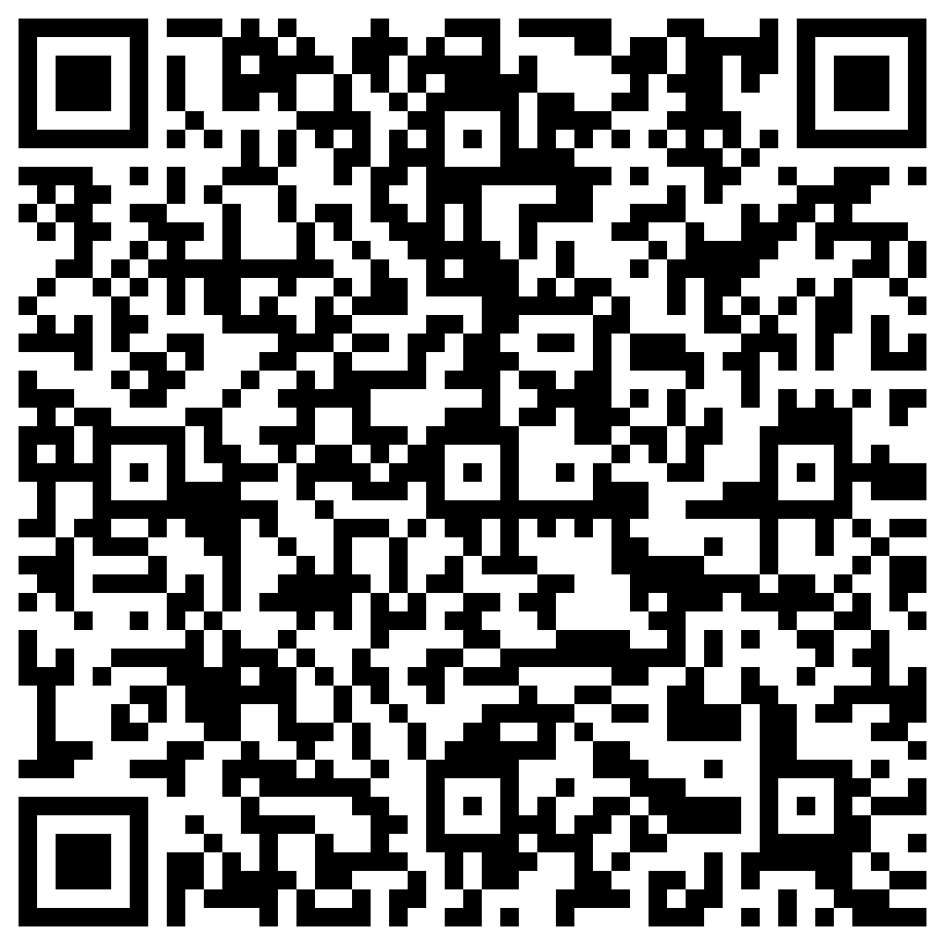



Thank you & More info!
Federal
Register
Publication
(1/2)
Link
Link
Kaili.gregory2012@gmail.com

