Slide 1
Are We Detecting New Pathogen Relationships For
Opuntia littoralis in San Diego County?
Opuntia littoralis / Fusarium brachygibbosum
SDMMP
16 SEPTEMBER 2021
JONATHAN DUNN
jonathan.dunn@aecom.com
AECOM

Slide 2
City of San Diego Cactus Conservation Nursery
In April 2021, AECOM was tasked with refurbishing the City of San Diego Cactus Conservation Nursery located on Highland Valley Road (Big Trees Nursery).
During the initial site visit, City and AECOM staff noted that the Opuntia mother-stock at the nursery looked unhealthy.

Slide 3
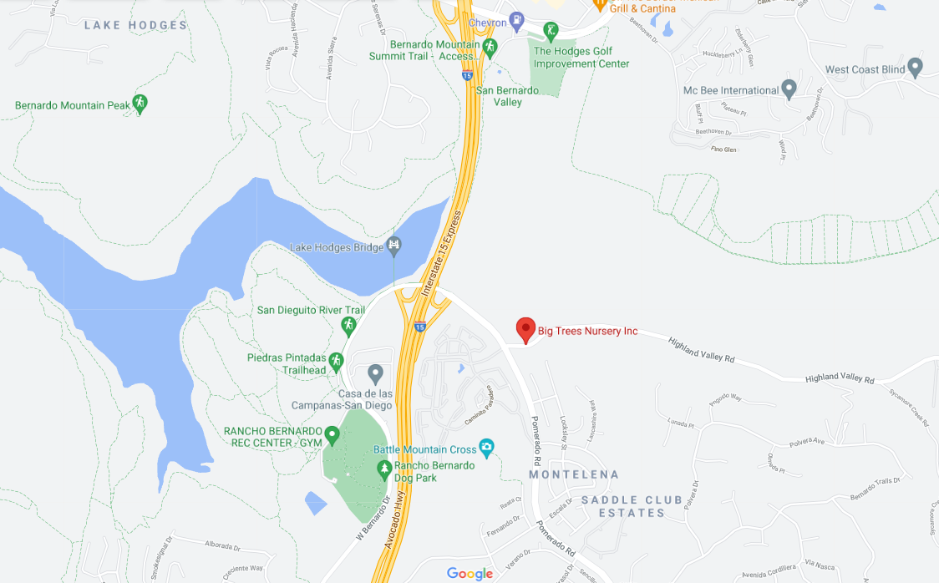

Slide 4
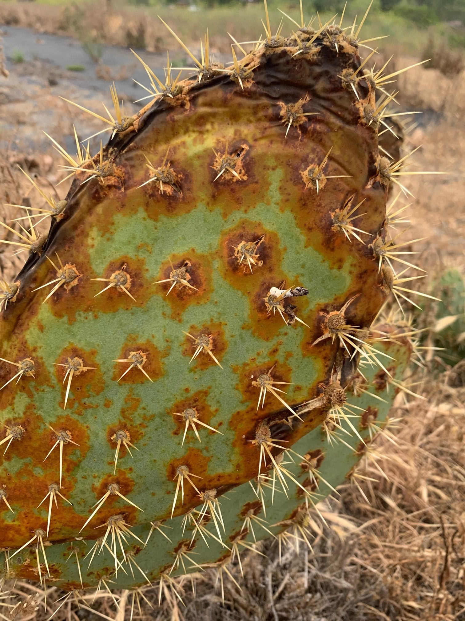
City of San Diego Cactus Conservation Nursery

Slide 5
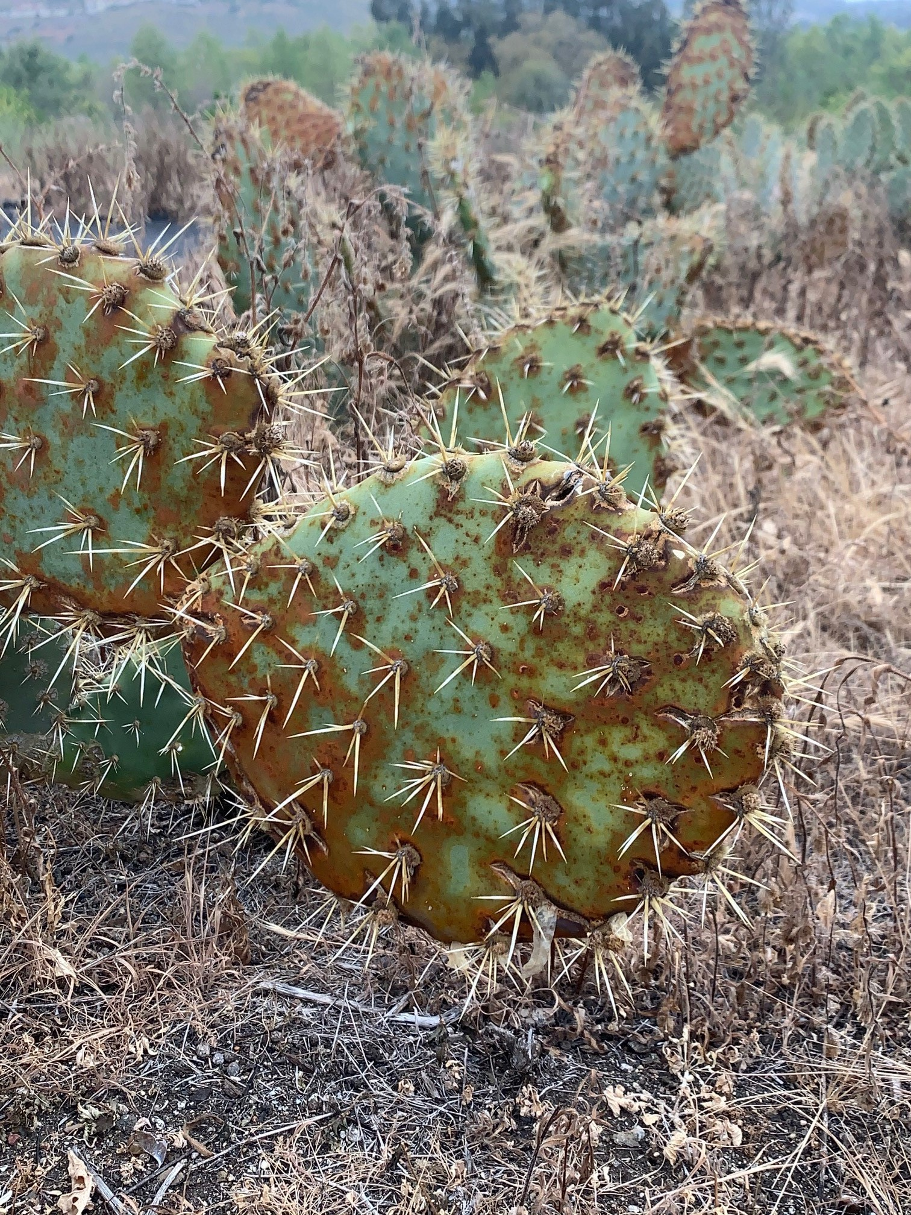
City of San Diego Cactus Conservation Nursery

Slide 6
Identification of Potential Pathogens
Samples were collected and sent to the UC Davis Plant Pathology Department for identification.
Testing (including molecular sequencing) was completed July 2021
The labs of Dr. Johanna Del Castillo and Dr. Akif Eskalen identified several possible pathogens

Slide 7
Identification of Potential Pathogens
Drs. Del Castillo and Eskalen identified two common fungi, Alternaria sp. and Cladosporium delicatulum, and a new plant/fungi relationship:
Opuntia littoralis / Fusarium brachygibbosum

Slide 8
Fusarium brachygibbosumen
First detection in California was in 2016 from samples (bare root almond trees) that had been collected in fall 2013, from a nursery in Sutter County
Common symptoms of F. brachygibbosumen infections are cankers, wilting and dieback

Slide 9
Fusarium brachygibbosumen
Reproduction
Sexual and Asexual Reproduction
Dispersal
Airborne and Soilborne

Slide 10
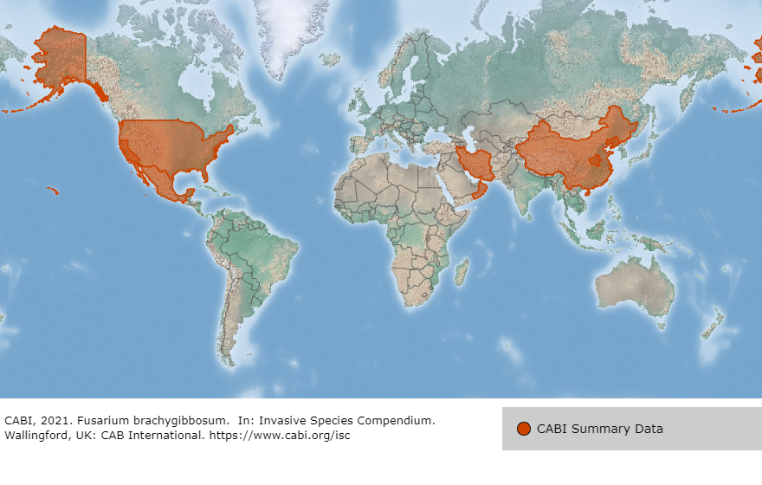
Fusarium brachygibbosumen

Slide 11
Fusarium brachygibbosumen
Known Plant/Pathogen Relationships
Alliaceae Allium cepa (onion)
Apocynaceae Nerium oleander (oleander)
Cucurbitaceae Citrullus lanatus (watermelon)
Euphorbiaceae Euphorbia larica (isbaq)
Fabaceae Glycine max (soybean)
Poaceae Sorghum vulgare (sorghum), Triticum spp. (wheat)
Solanaceae Nicotiana tabacum (tobacco)
Rosaceae Prunus dulcis (almond)
And now
Cactaceae Opuntia littoralis (prickly pear)

Slide 12
Fusarium brachygibbosumen
Notification of Presence in San Diego County
County of San Diego
Department of Agriculture, Weights and Measures
University of California Cooperative Extension

Slide 13
Additional Testing
In August 2021, additional samples from the nursery were sent to the UCD plant pathologists
F. brachygibbosumen was not detected in these samples, however, this taxon is can be cryptic and hosts may remain asymptomatic without stressors
Alternaria alternata, Alternaria caespitosa, and Cladosporium cladosporoides were identified
Species of both Alternaria and Cladosporium are known to cause leaf spot in plants

Slide 14
Next Steps
Continued studies by UCD to determine the likely disease vector(s)
Surveys and sampling to determine regional extent of disease

Slide 15
Next Steps
Continued studies by UCD to determine the likely disease vector(s)
Consideration of possible treatment options in cooperation with University of California Cooperative Extension
Surveys and sampling to determine regional extent of disease

Slide 16
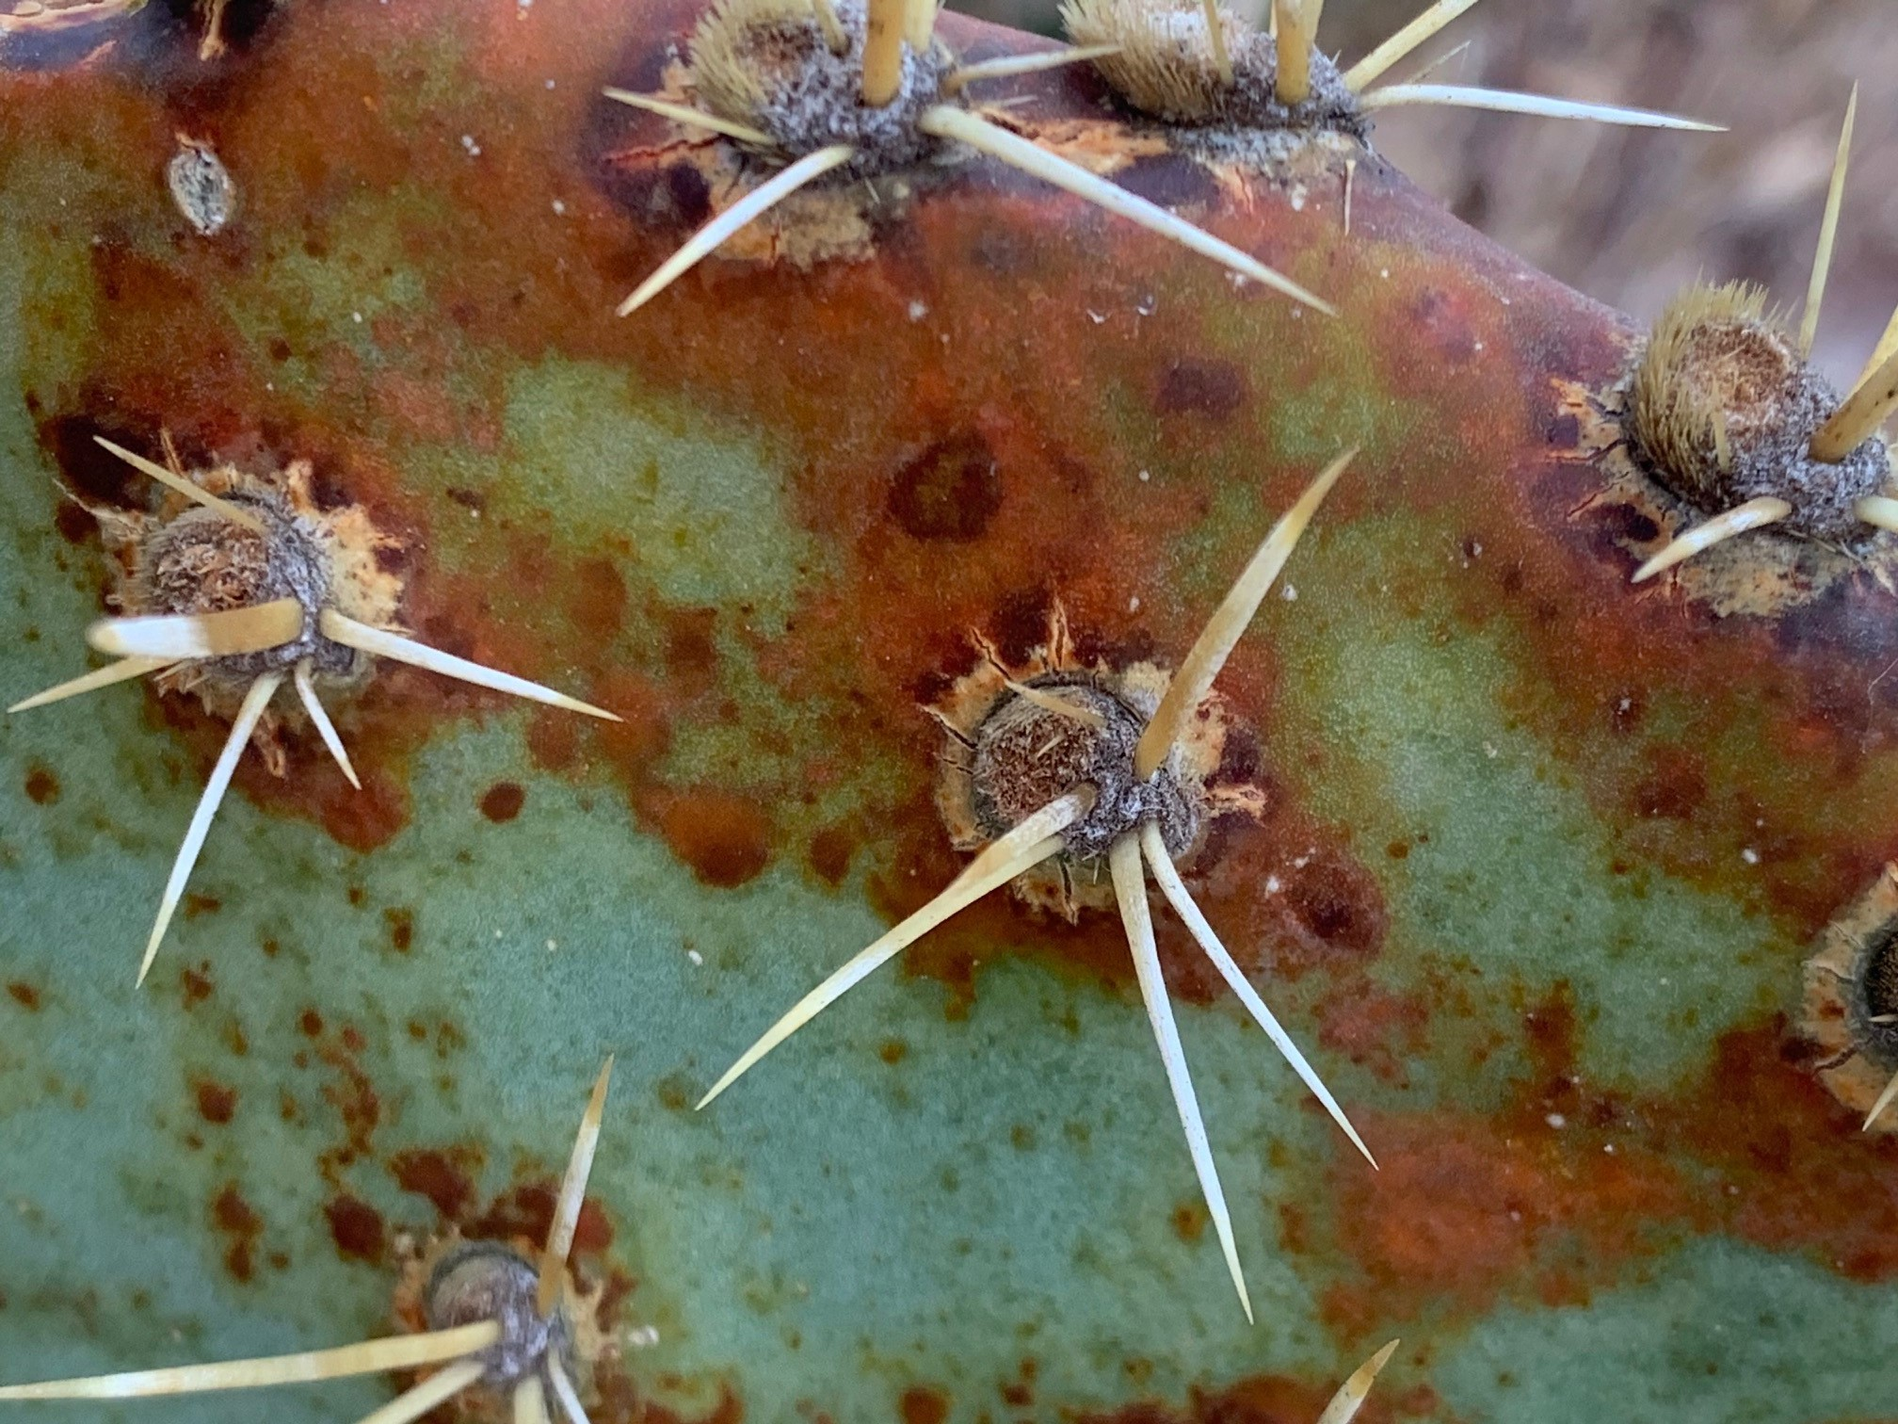
Keeping Eyes on Opuntia littoralis

Slide 17
Keeping Eyes on Opuntia littoralis
Additional information will be provided as more is known
Questions?
Kris Preston (SDMMP) kpreston@usgs.gov
Kim Wehinger (City of San Diego) kwehinger@sandiego.gov
Jonathan Dunn (AECOM) jonathan.dunn@aecom.com

Slide 18
Fusarium brachygibbosumen
Additional information will be provided as more is known about treatment and prognosis
Questions?
Kris Preston (SDMMP) kpreston@usgs.gov
Kim Wehinger (City of San Diego) kwehinger@sandiego.gov
Jonathan Dunn (AECOM) jonathan.dunn@aecom.com

Slide 19
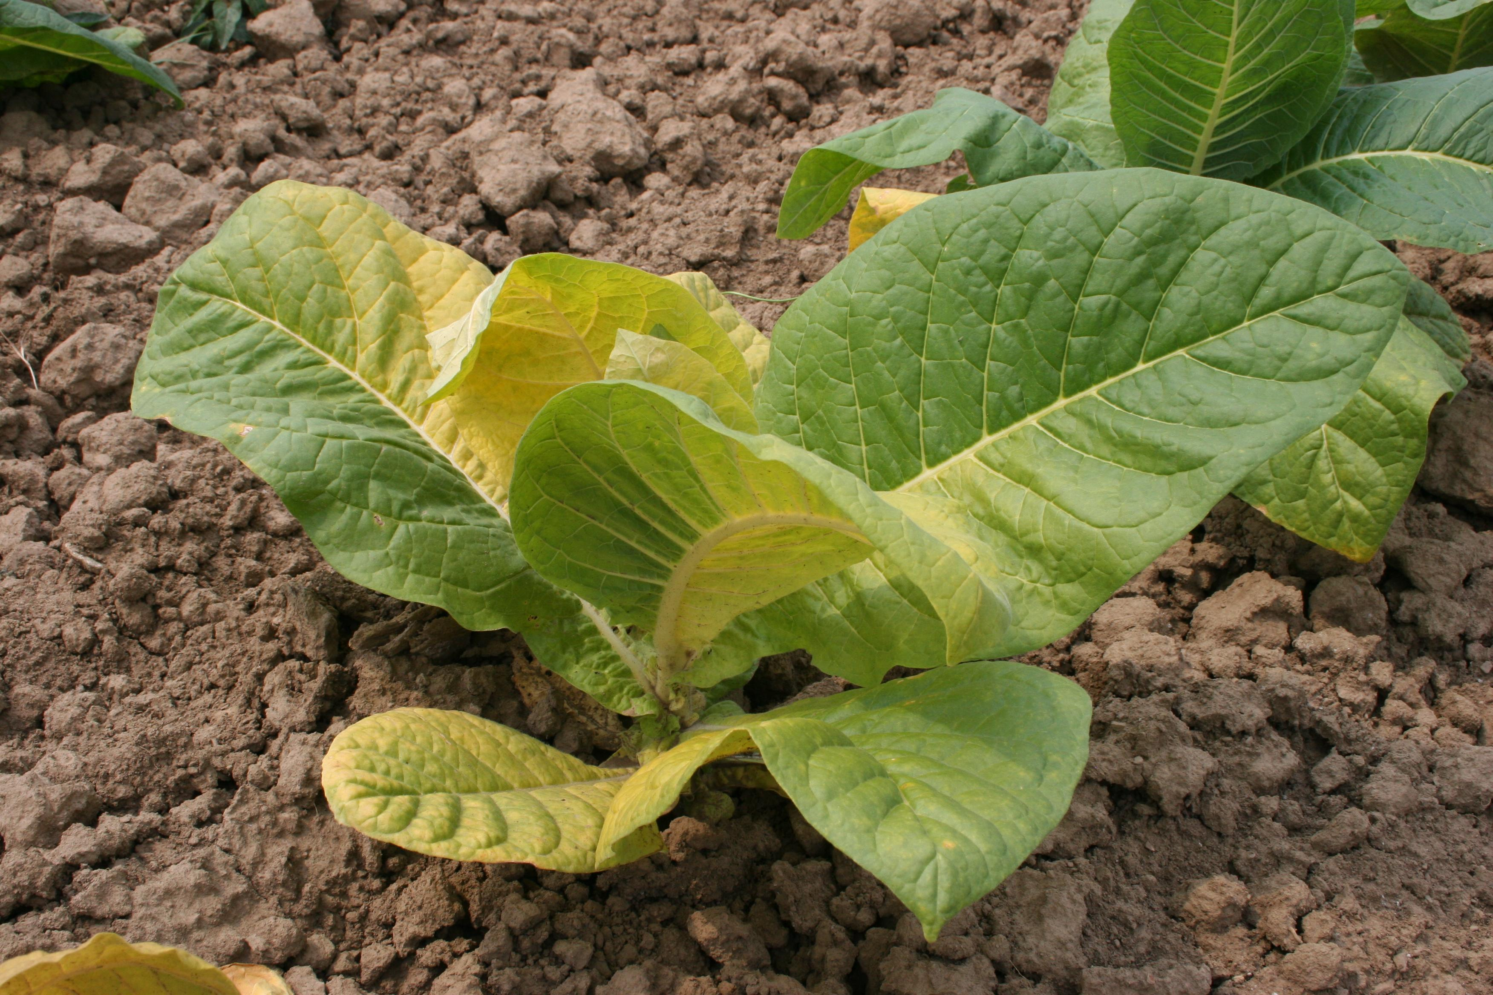
Fusarium Wilt on Tobacco

