Slide 1
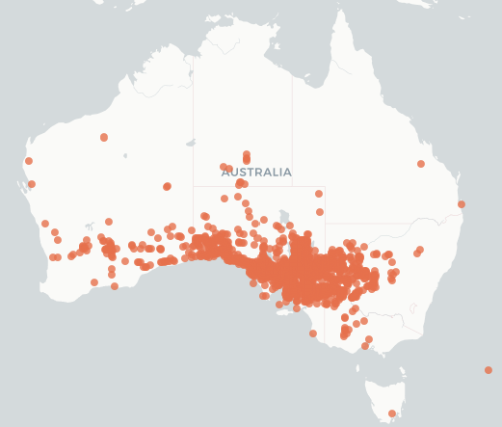

Slide 2
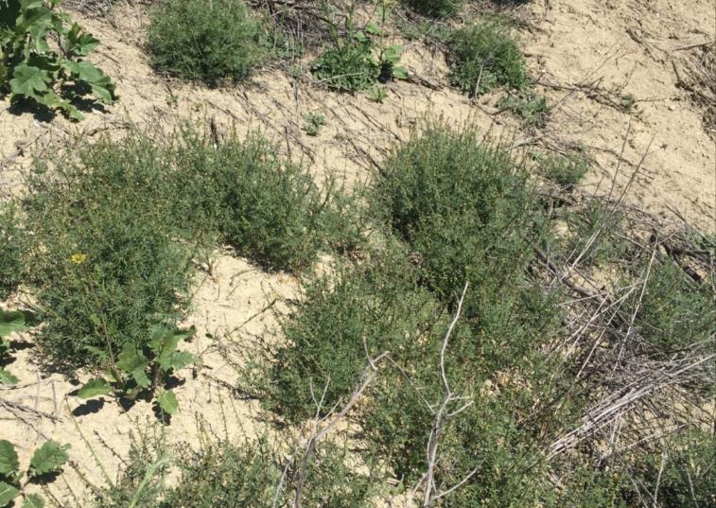
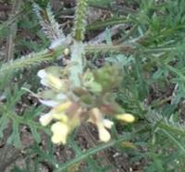
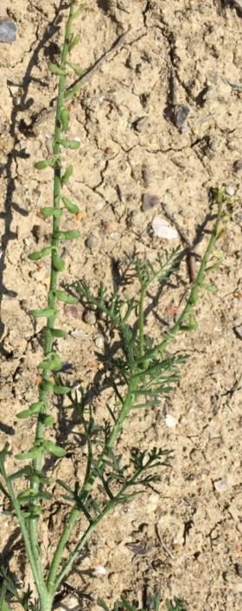
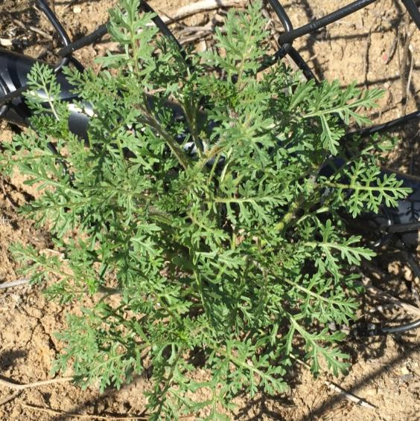
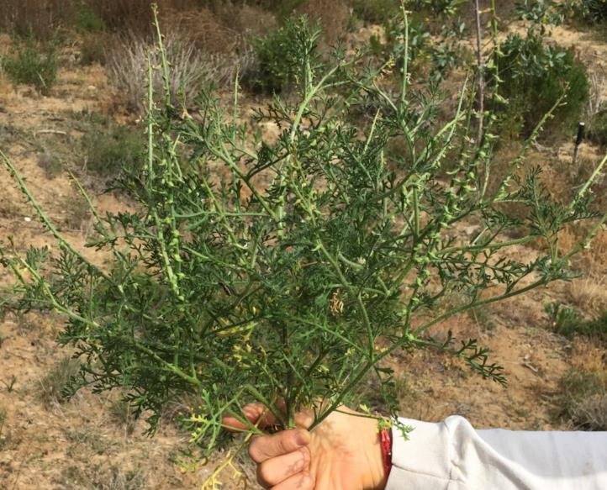
Invasive Non-Native:
Ward’s weed
(Carrichtera annua)
Description: Plant size varies from small to multi-branched 0.5m ht; Stems branched basally and distally; form similar to a small tumbleweed; Basal leaves: petiole 1–4.5 cm; blade 3-6 lobes each side, 1.5-4 cm, terminal lobe linear to oblong, margins entire. Flowers white or creamy yellow petals 6.5-8 x 1-2 mm ; Fruits short reflexed pods.
Ecology: Plant size varies greatly depending on environmental conditions; prefers disturbed areas, but readily invades between and under shrubs; coastal sage, maritime chaparral, grasslands
All photos Jason Giessow
Report sightings to: edrrsd@gmail.com and database at www.Calflora.org

Slide 3
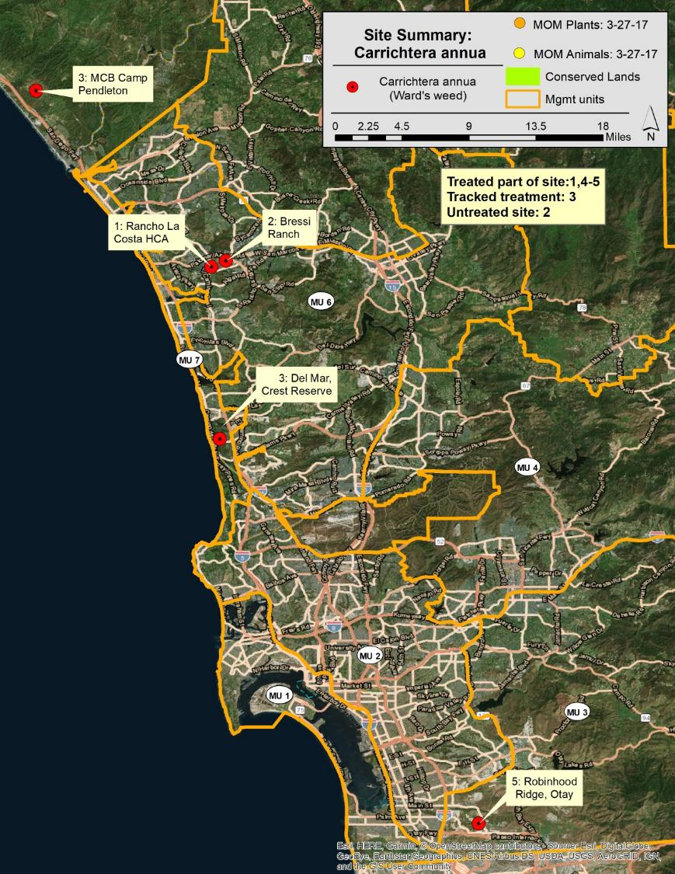

Slide 4
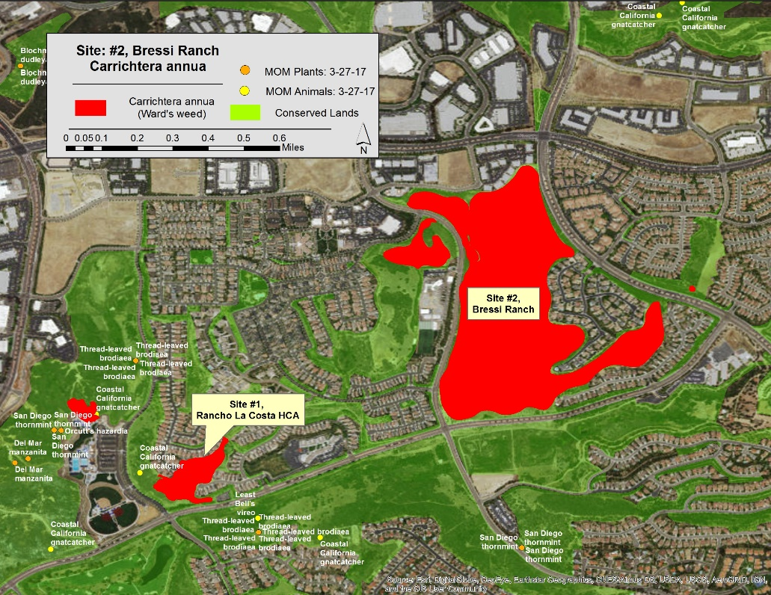

Slide 5
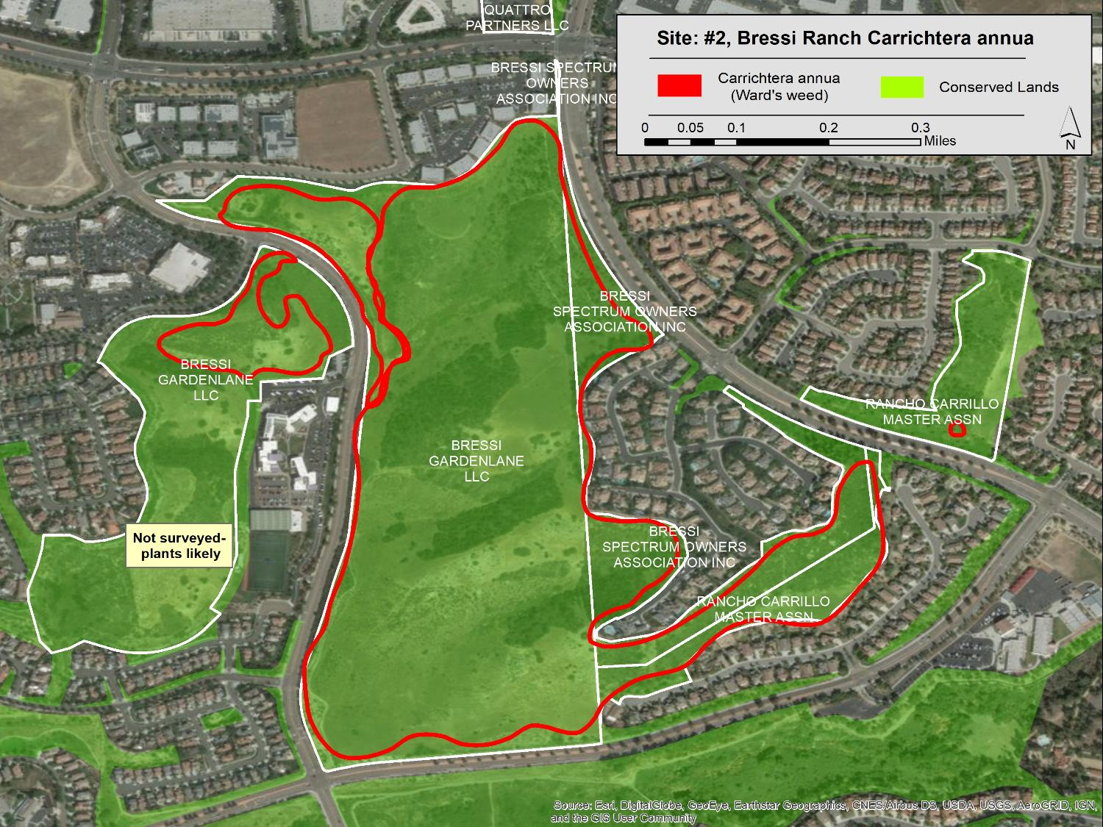

Slide 6
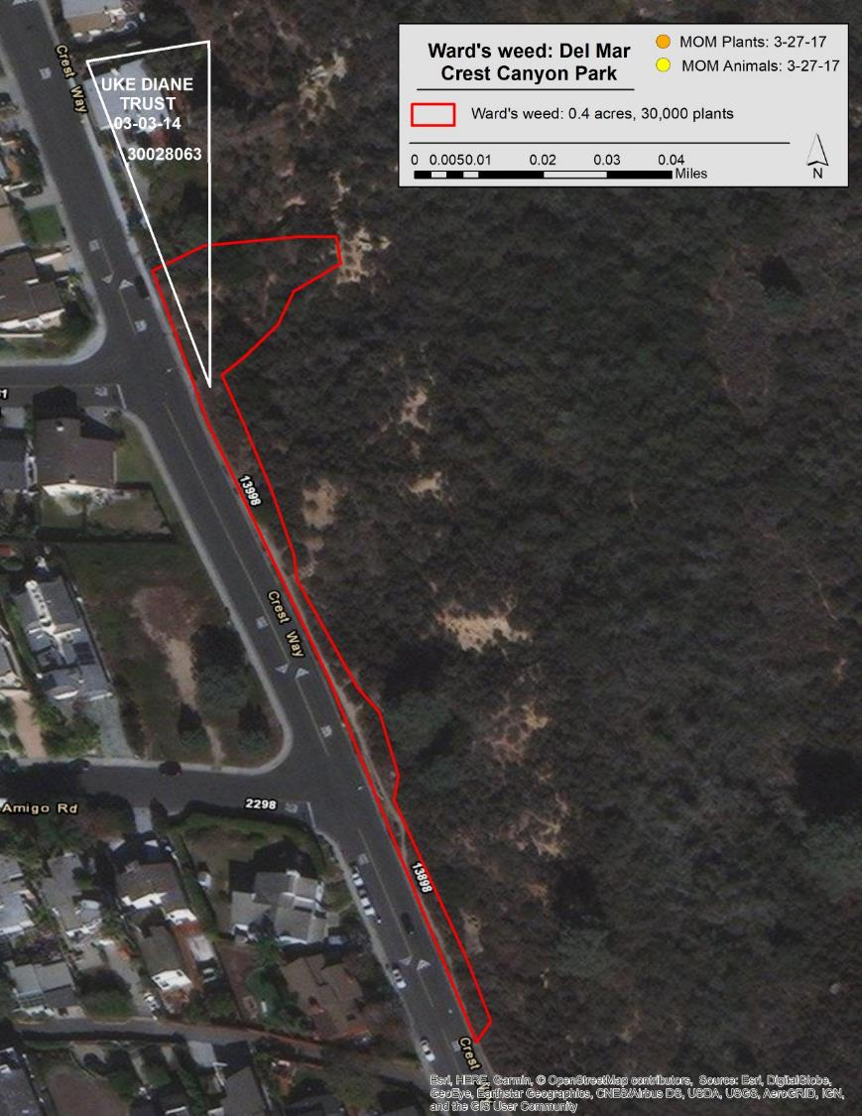

Slide 7
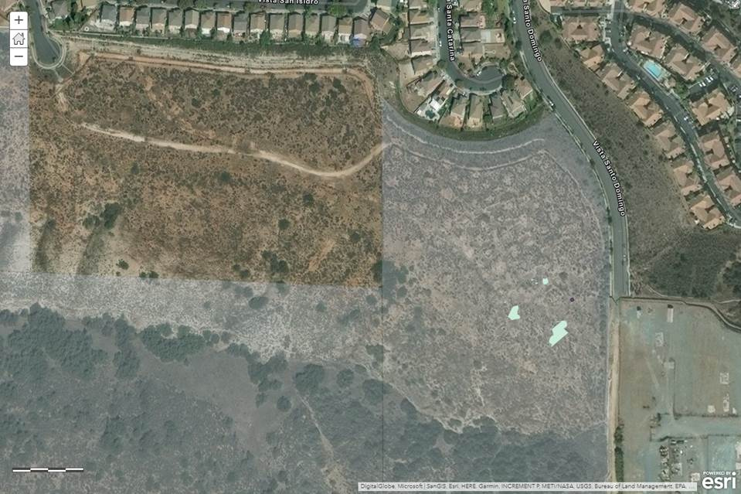

Slide 8
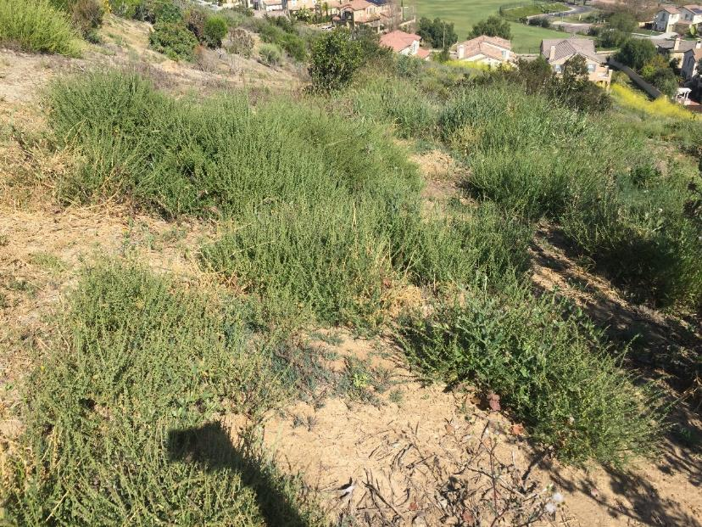
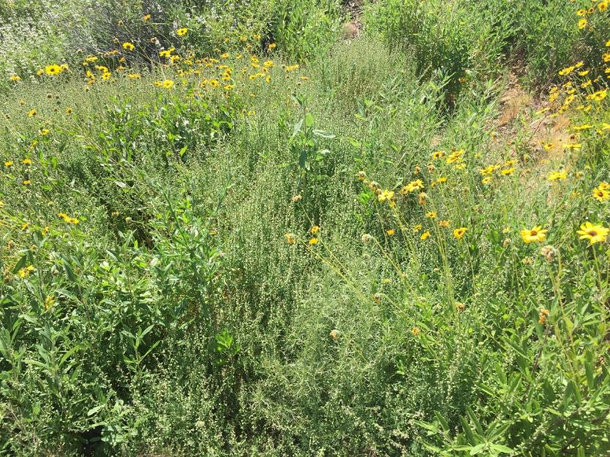

Slide 9
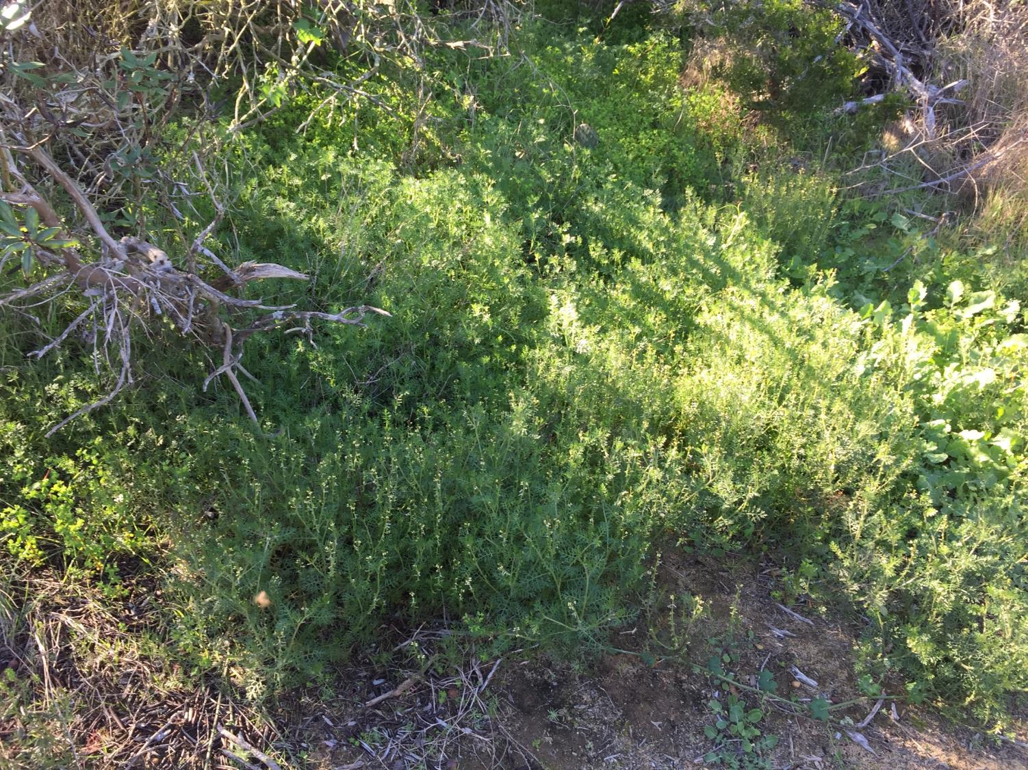

Slide 10
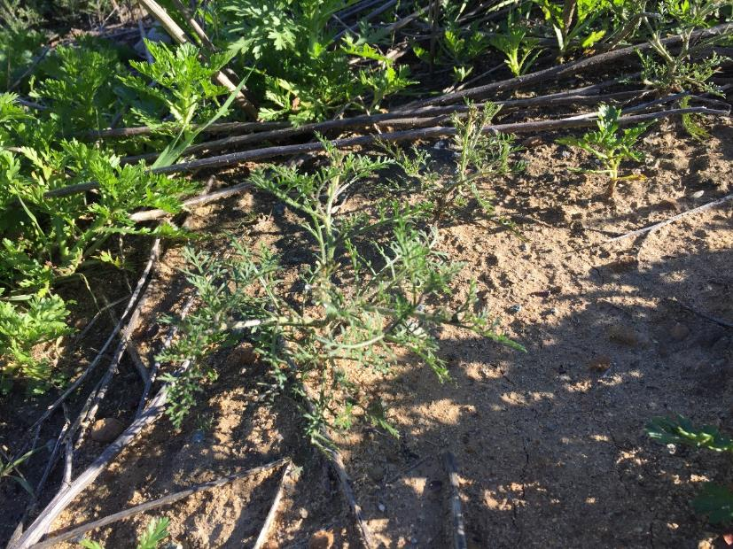
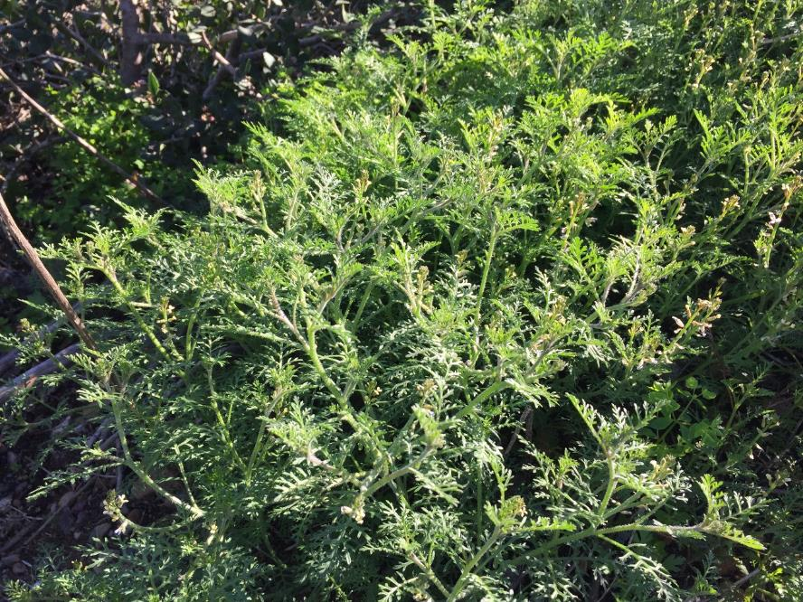

Slide 11
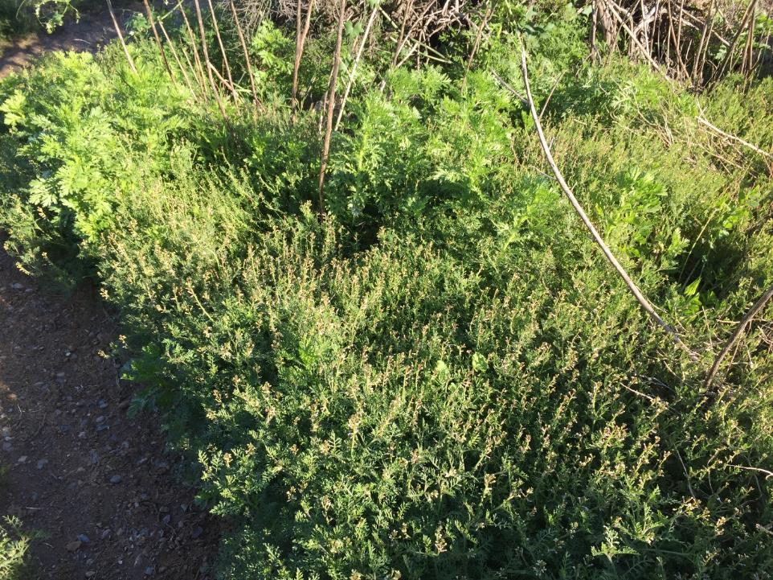
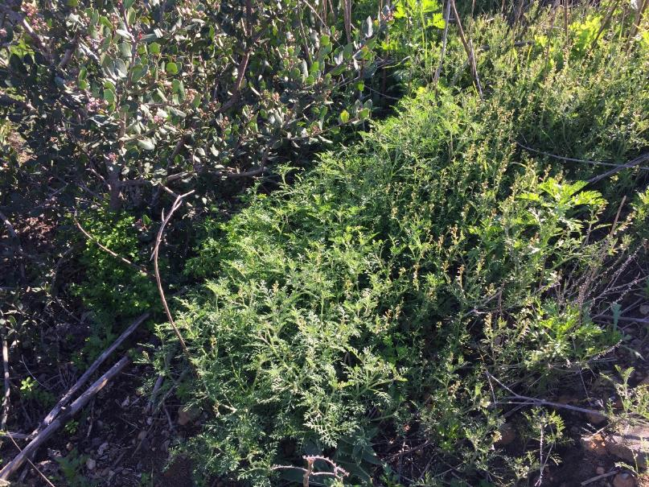

Slide 12
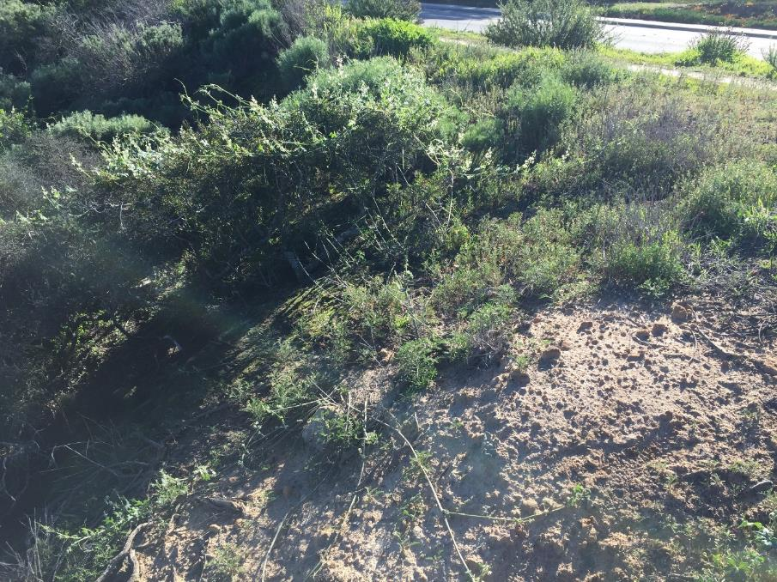


Slide 13
Ward’s Weed Treatments
Telar (chlorsulfuron):
broad-spectrum, great on mustards, controls annuals/seedlings
Glyphosate (spot treatments):
broad spectrum, post emergent
Gallery (isoxaben):
broadleaf control, pre-
Hand pulling:

