Slide 1
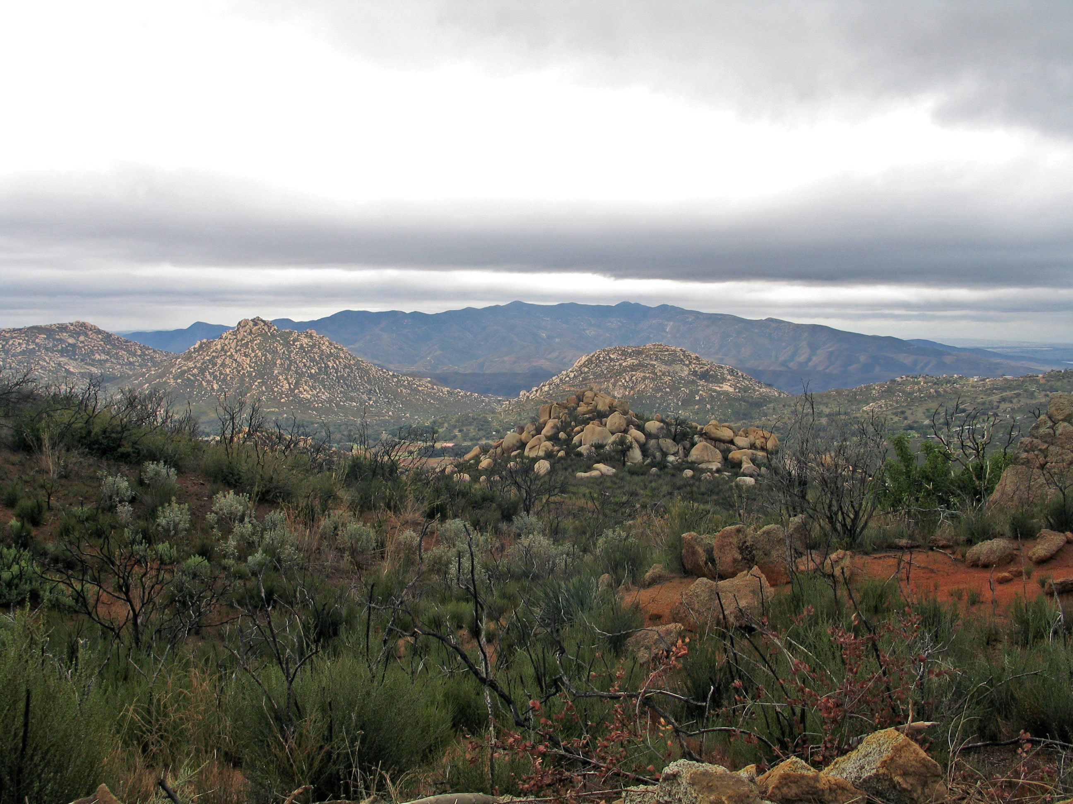
Preserve Metrics Update San Diego Management & Monitoring Program
Group 2 Rare and Speicalist Species
March 5, 2021
Photo: Jessie Vinje, CBI

Slide 2
Introduction
Kris will do
About 10 mins

Slide 3
Notes:
Go through an example of each indicator: 1 slide for each indicator that talks about why we are doing (why are we picking this species; what’s the overall condition)
-Landscape scale: mountain lion
-Rare & Specialist: pond turtle & quick one on rare plants (Kris)
-Habitat/ Veg. Community Species: cactus wren (Annabelle), may not have the genetics done
-Veg community: CSS (Emily)

Slide 4
Emily explain dashboard (5 mins)

Slide 5
Hermes (Kris & Annabelle, Emily Dashboard) ~ 15-20 mins
Kris: intro, Annabelle: map, Emily: dashboard driving
Show dashboard example & maybe ESRI Dashboard (Emily)
Maps of occurrences
# of extant populations over time (graph); have # of butterflies counted each year at each site. Compile data from Dan’s stuff
Show by year what was surveyed and what the results were (detected, not detected). Annabelle make in GIS and Emily add to dashboard?

Slide 6
Quino? (Kris) ~10-15 mins
Figuring out what we can do

Slide 7
Rare Plants (Kris & Emily) 30 mins (at most)
Each species: thornmint, acmispon, tarplant, Encinitas Baccharis, willowy monardella
Kris explain, Emily drive

Slide 8
Wrap up (5-10 mins)

Slide 9
Closing SLide

